Slide 1
What is the best BEER?
Unit 9 Case Study of Breweries
Morgan Nelson
Michael Hedge

Slide 2
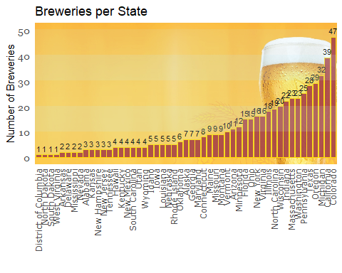
How many breweries per state
Colorado has most breweries with 47
States with only 1 brewery
DC, N. Dakota, South Dakato, W. Virginia

Slide 3
Solution for missing data
1405 of 2410 IBU values missing
62 of 2410 ABV values missing
Use kNN to find ABV and IBU values for missing sample data
Using kNN did not change the median ABV and IBU data values
*We feel that this was best solution outside of complete data set*

Slide 4
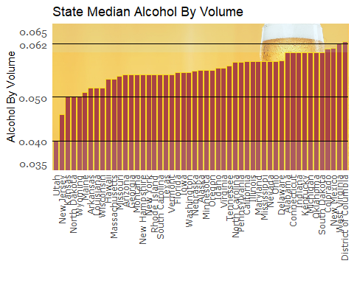
Median ABV per state
DC has highest median ABV 0.065 with W. Virginia next with 0.062
Utah has lowest median ABV at 0.040

Slide 5
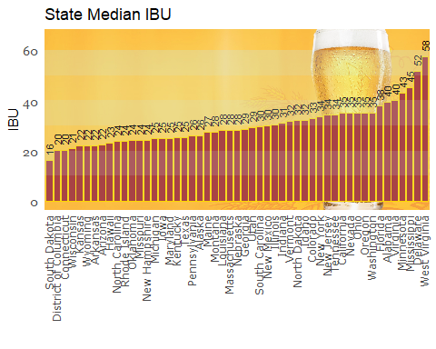
Median IBU per state
W. Virginia has highest median IBU at 58, Delaware is next with 52
S. Dakota has lowest median IBU at 16

Slide 6
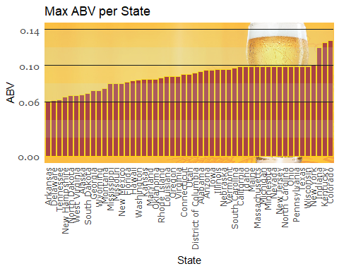
Max ABV
Colorado has highest ABV 0.136 with Kentucky next with 0.135
Arkansas has lowest ABV at 0.006

Slide 7
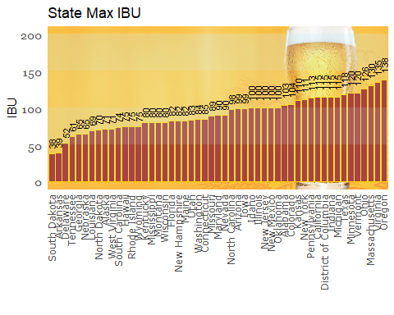
Max IBU
Oregon has max IBU of 138
S. Dakota has min IBU of 38

Slide 8
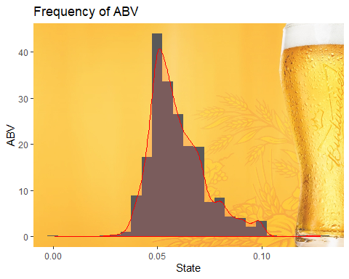
ABV stats and distribution
Average ABV is 5.9%
Min ABV is 0.1%
Max ABV is 12.8%

Slide 9
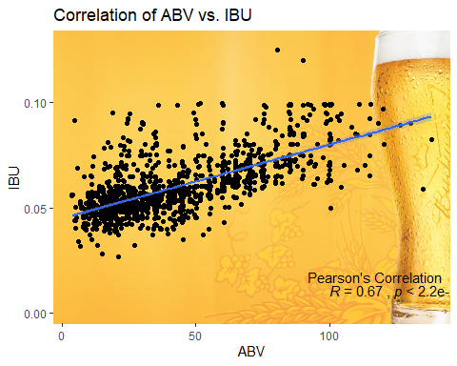
ABV to IBU
ABV
Original data has correlation of 67%
IBU

Slide 10
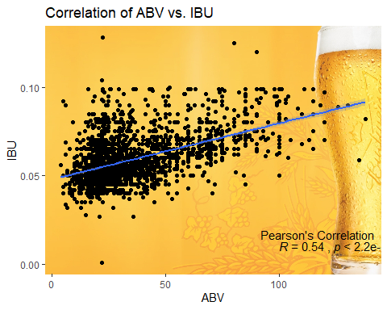
ABV to IBU
ABV
kNN filled data has correlation of 54% which is due to large clustering of filled data below 50 IBU
IBU

Slide 11
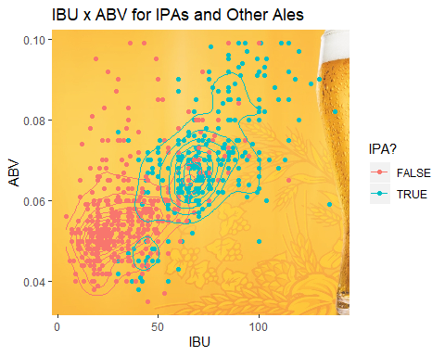
Compare IPAs to other Ales
IPA
PALE ALE

Slide 12
kNN on IPAs to other Ales
Since there was a distinction between IPAs and other Ales, we are able to use kNN
We trained the kNN Classifier on IPAs and other Ales, based on ABV and IBU
*We can predict with 92% accuracy whether a beer is an IPA or other Ale*

Slide 13
Additional Analysis
If we assume that:
current breweries are selling most of their beer locally
that they are making beers which sell well in their areas
kNN Classifier will predict with 30% accuracy which state a type of beer is from based on ABV, IBU and Style.
*This allows us to market “our” beer to states that are more likely to buy them!*

